Slide 1
Maze Game Wireframes
Design Notation learned from:
https://www.slideshare.net/unthank/game-design-2-lecture-5-game-ui-wireframes-and-paper-prototypes

Slide 2
Legends - All objects within a certain ‘type’ will have the attributes associated with its legend. Any unique traits will be defined in the instance of the object in a wireframe.
Legend for ‘button’ type object:
Font: Candara
Font Colour: RGB(89,103,181)
Button colour: RGB(124,176,255)
Button border colour: RGB(89,103,181)
Text align: centre
Legend for ‘text’ type object:
Font: Candara

Slide 3
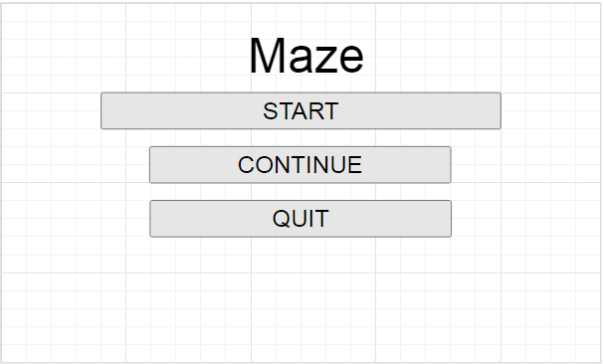
Main Menu Wireframe (Continue unclicked)
Commentary
Maze Text Commentary
Object Type: Text
Font colour: RGB(89,103,181)
Size: 96px
Function: Main Menu Title
1200px
Start Button Commentary
Object Type: Button
Font Size: 48px
Function: Starts up main game (see ‘Main Game, no esc menu’ wireframe)
Continue Button Commentary
Object Type: Button
Font Size: 36px
Function: Checks if there is a save file and if there is, loads the data. If there is not, it displays an error message (See next page)
Quit Button Commentary
Object Type: Button
Font Size 36px
Function: Uninitialised the game and closes it.
General commentary
All Screens seen from henceforth will be 1200px * 720px.
Background Colour: RGB(0,0,0)
720px

Slide 4
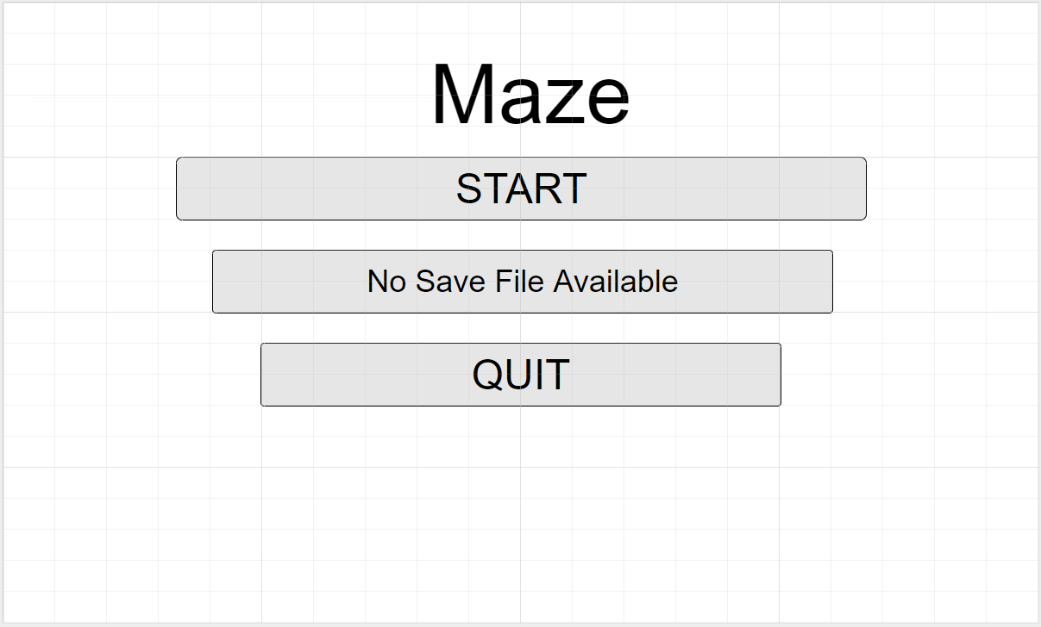
Commentary
Main Menu Wireframe (Continue clicked)
General Commentary
Start and quit buttons have the exact same attributes as Main Menu Wireframe (Continue unclicked).
Background colour is same as previously
Continue Button/No save error commentary
Previous continue button is no longer useable and ‘No Save File Available has been painted over it. This occurs if the continue button has been pressed without a save file present.
Object Type: Error Message
Font: Candara
Font Size: 36px
Font Colour: RGB(29,41,81)
Background colour: RGB(89,103,181)
Border colour: RGB(29,41,81)
Text align: centre
Function: Placeholder when there is no save file.

Slide 5
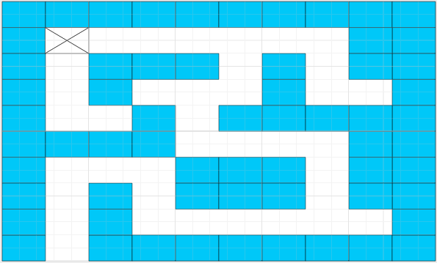
Commentary
Main Game (first maze), no esc menu Wireframe
Maze commentary
All coloured in blocks are the ‘walls’ of the maze. The player cannot collide with them. All blank spaces are space which the player can move through. Each wall is made up by one ‘block’.
Object type: Block
Block Colour: RGB(124,176,255)
Block Border: Colour: RGB(89,103,181)
Block Width: (1200/10)px
Block Height: (720/10)px
Player commentary
The box with the X in it represents the place where the player block spawns if the game is not being loaded from a save file. The player can move through any of the white spaces. It will be represented by a red block, 10px less in width and height than the maze wall boxes, centred in each ‘block’ area.
When being loaded in, the player block may spawn in any of the blank spaces, based on the save data. If player reaches the edge of the screen, the ‘you win’ screen will appear. (See winning Wireframe)
Object Type: Player
Player Colour: RGB(220,20,60).
Player Width: Block Width - 10px
Player Height: Block Height - 10px
Background colour: RGB (0,0,0)

Slide 6
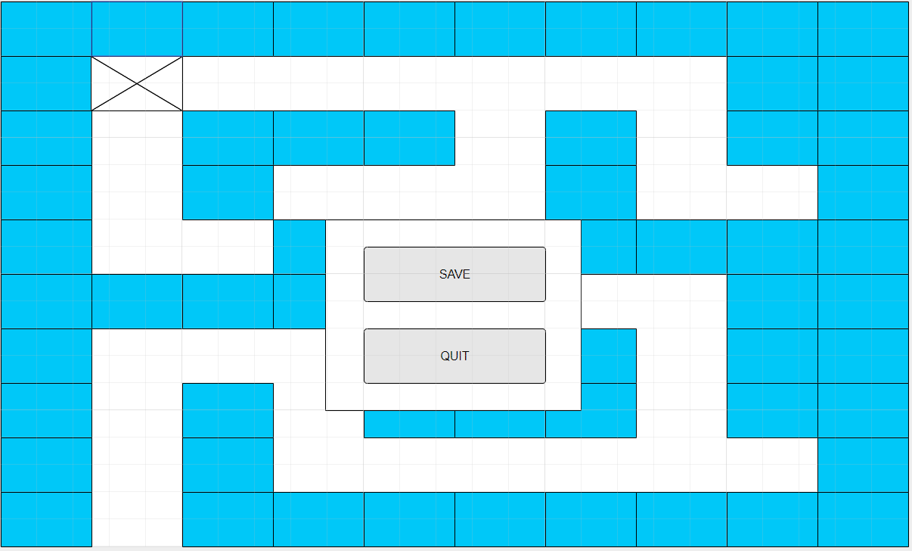
Commentary
Main Game (first maze), with esc menu
General Commentary
Everything ‘behind’ the menu will be completely paused and user will only be able to interact with menu
Maze and player are the same, as is background colour.
Menu Border Commentary
Object Type: In-Game Menu
Menu fill colour: RGB(89,103,181)
Menu border colour: RGB(29,41,81)
Menu Width: (1200/25)*7
Menu Height: (720/20)*7
Function: Differentiates between menu and maze.
Save Button Commentary
Object Type: Button
Button border colour: RGB(29,41,81)
Font Size: 38px
Function: Saves player position and maze to an external file
Quit Button Commentary
Object Type: Button
Button border colour: RGB(29,41,81)
Font Size: 38px
Function: Returns to the Main Menu (See Main Menu, continue unclicked)

Slide 7
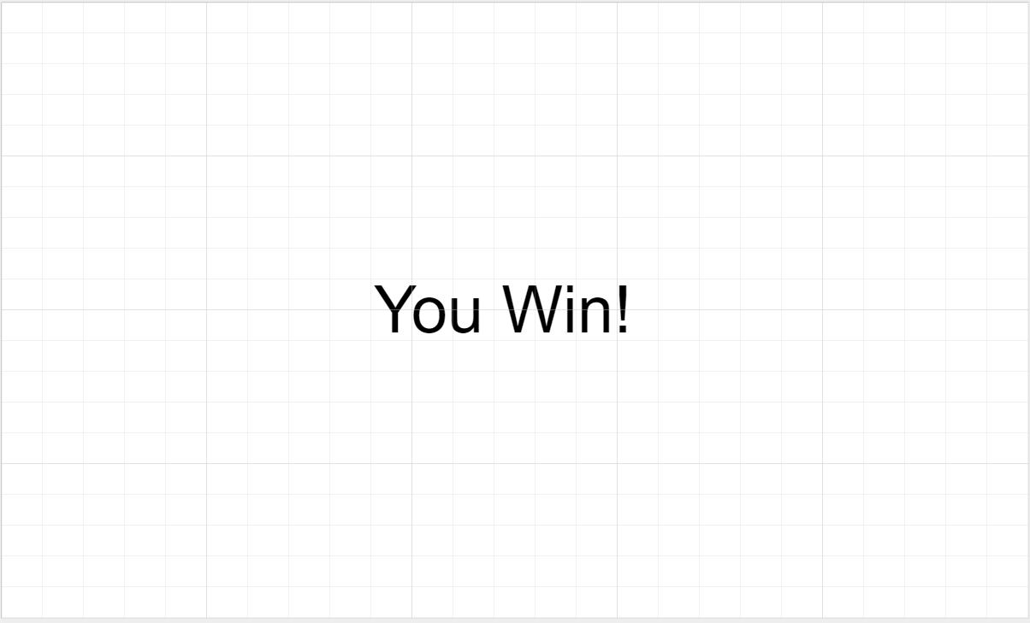
Winning Page
General commentary
This will appear for a few seconds after the player has reached the edge of the screen. After a few seconds, the screen will return to the Main Menu.
Background colour: RGB(0,0,0)
‘You win’ Text
Object Type: Text
Font Colour: RGB(255,255,255)
Font Size: 76px

Slide 8
Main Menu Page flowchart
Press quit button
Uninitialise python and quit game
Main Menu
(Continue clicked)
Press quit button
Press continue button
N
Is there a save file?
Main Menu
(Continue Unclicked)
Y
Press Start button
Main Game (No esc pressed, player position based on loading or not loading)

Slide 9
Main Game Page flowchart (Assume there is a save game)
Main Game (No esc pressed, player position dependent on loading status)
Player reaches edge of screen
Press continue /Start button
Press esc key
Press esc key
Main Menu (See previous page)
Main game (esc pressed)
Data saved to file
Win Game Screen
Press quit button
Press save button

